Slide 1
KGE 2022
Trentino Weather
A KGE Project for weather measurement and forecasting
Giacomo Lazzerini
Jacopo Clocchiatti

Slide 2
The topic

Slide 3
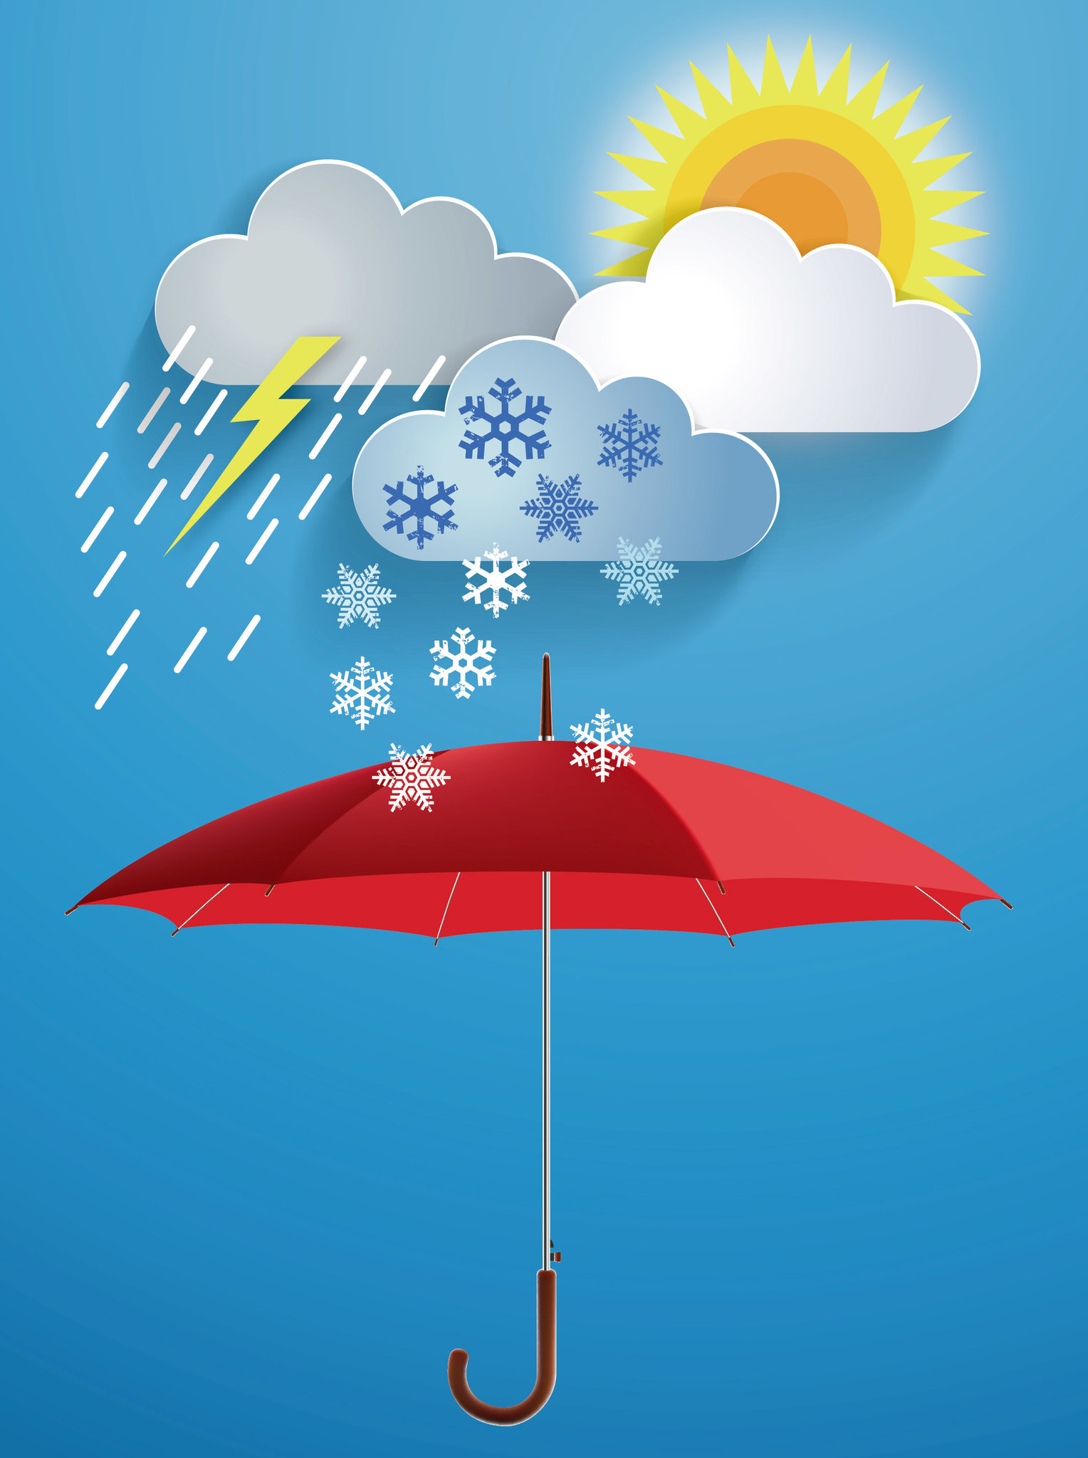
Purpose
“A service which helps users to know about the various weather observation sites and weather forecasts in different parts of Trentino.”

Slide 4
Domain of Interest
Geographical
Autonomous Province of Trento
Temporal
from a day before to the moment of the query for weather measurements
from the moment of the query to five days in the future for weather forecasts
from 1973 to 2022 for historical data

Slide 5



Data Sources
italian web company specialized in the provision of services and communi-
cation of weather forecasts.
data catalogue that al-
lows you to search, access, download, and preview open data collected in the Trentino province
through a single access point.
Python library that computes positions for the stars, planets, and satellites in orbit around the Earth.

Slide 6
Purpose Formalization
What’s the Scenario?
Past
Present
Future
Access information collected in the past
Access weather measurements in real time.
Forecast about weather within a few hours or days
Aggregated Data
Measurements
Forecasts

Slide 7

Purpose Formalization
Who needs this resource?
People
People that need weather services for everyday usage for travels, outdoor activities, transportations, etc.
Enterprises
People running business activities that need additional data for historical data, monitoring, planning, etc.

Slide 8

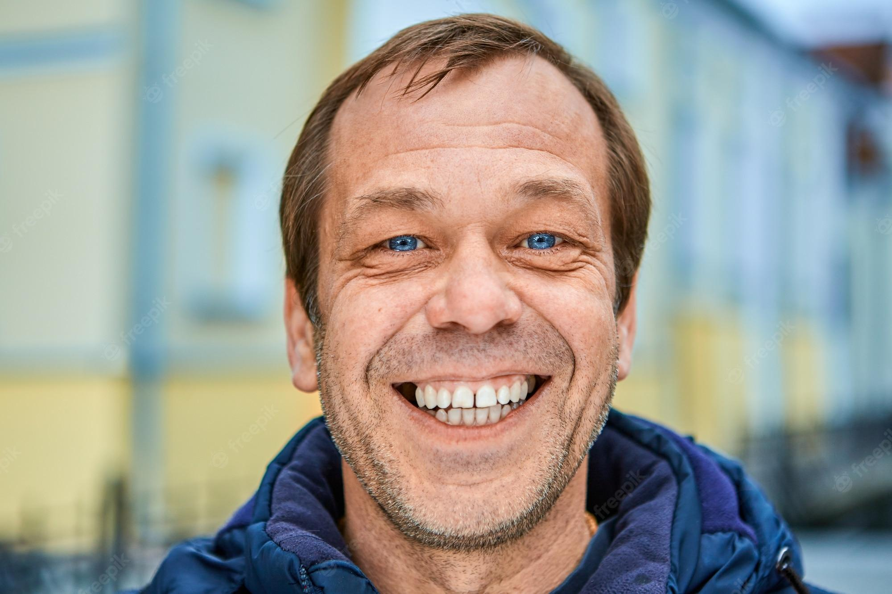
Purpose Formalization
Who needs this resource?
(examples)
People
Enterprises
Suzanne Van Houten
Antonio Quadrizi
She is a 67-year-old woman that recently retired and now she’s traveling all around Europe discovering new places. She is in Trento for the first time and wants to explore the city and its surroundings.
He is a 49-year-old owner of several organic (BIO) vegetable plantations all around Trentino. He has been running an agricultural business for 20 years and the company is continuing to grow.

Slide 9
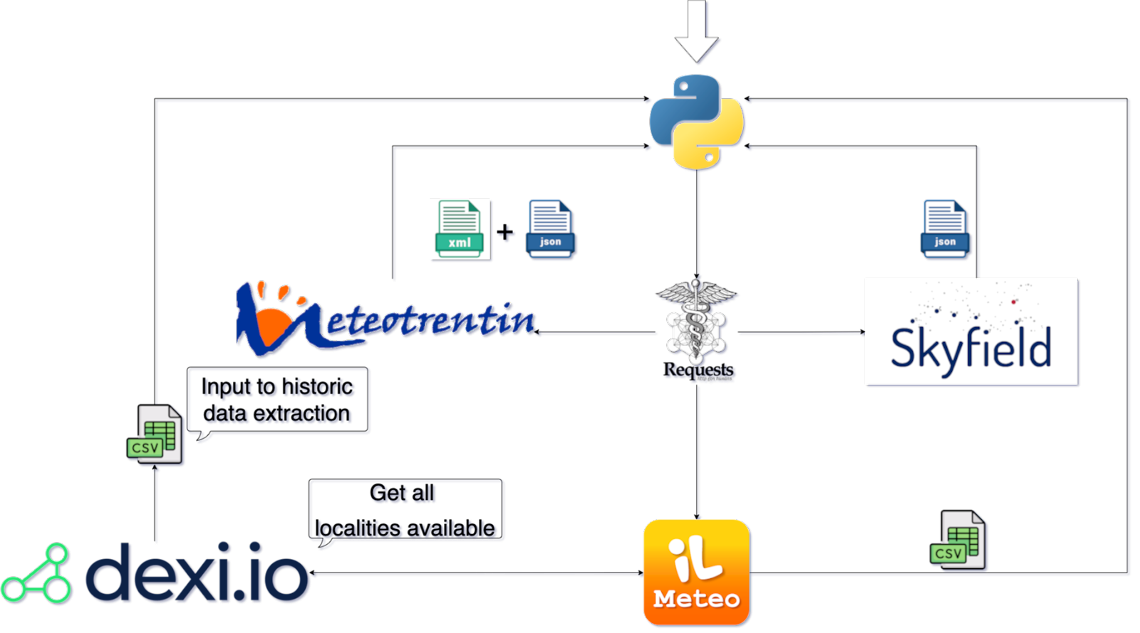
Inception
Output
6 File JSON
Localities
Weather Station
Weather Measurements
Weather Report
Weather Forecasts
Astronomical Status
1 File CSV
Historical Weather Data

Slide 10
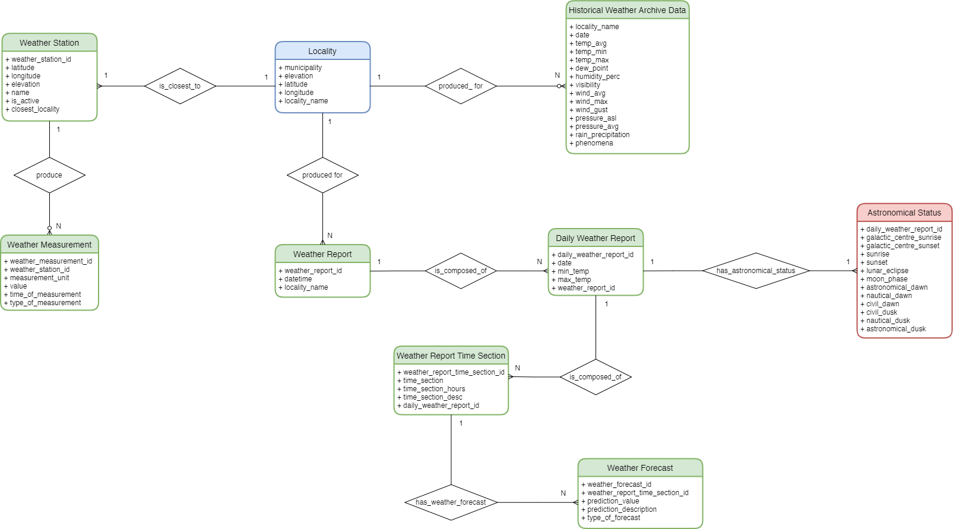
Informal Modeling
ER model
Section Break
Slide Title

Slide 11
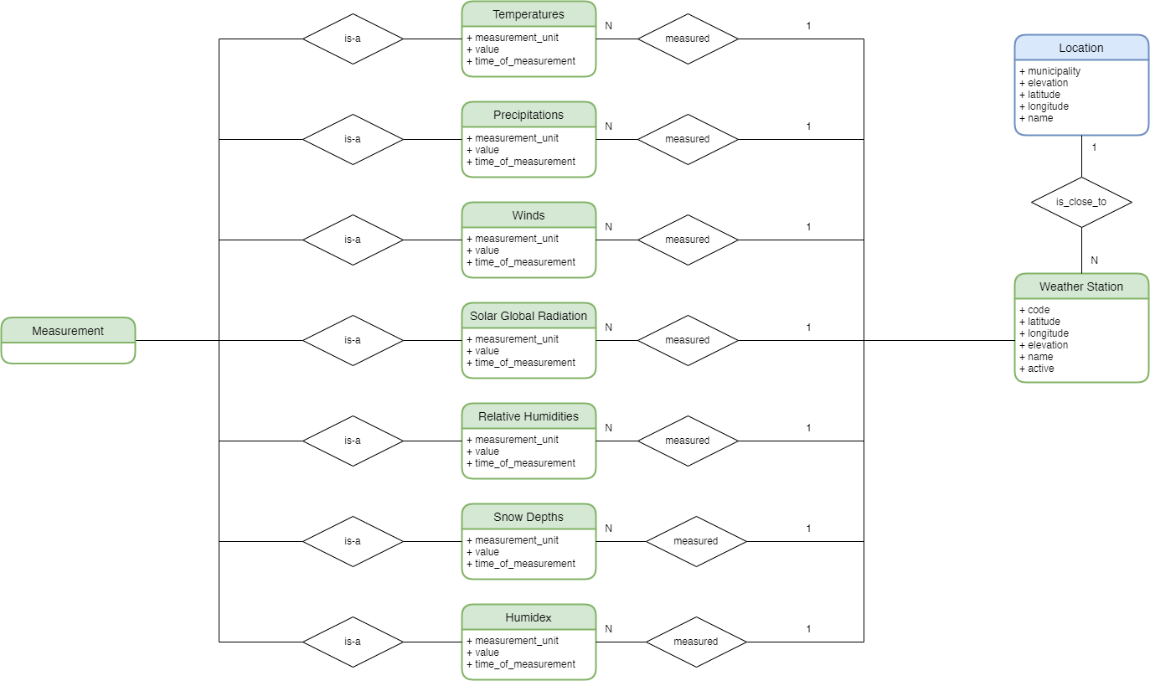
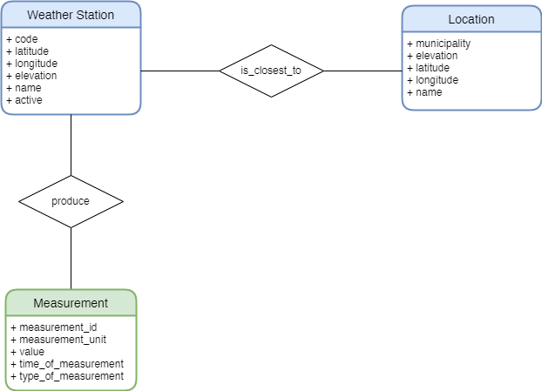
vs
Discarded solution with the explicitation of each type of measurement
Generalization in Measurement
Etype

Slide 12

Handling Streams
The approach is to break down teleological streams into two or more teleologies to be composed at different instances. In our case, we should first use a teleology that models the context in which streams evolve like in a framework.

Slide 13
Formal Modeling
Building Teleontology
ontologies
geo:SpatialThing
time:TemporalAggregate
Locality, Weather Station
Weather Archive Data
km4c:WeatherReport
sosa:Observation
Astronomical Status, Weather Forecast
Weather Measurement
time:interval
Weather Report, Daily Weather Report, Weather Report Time Section

Slide 14
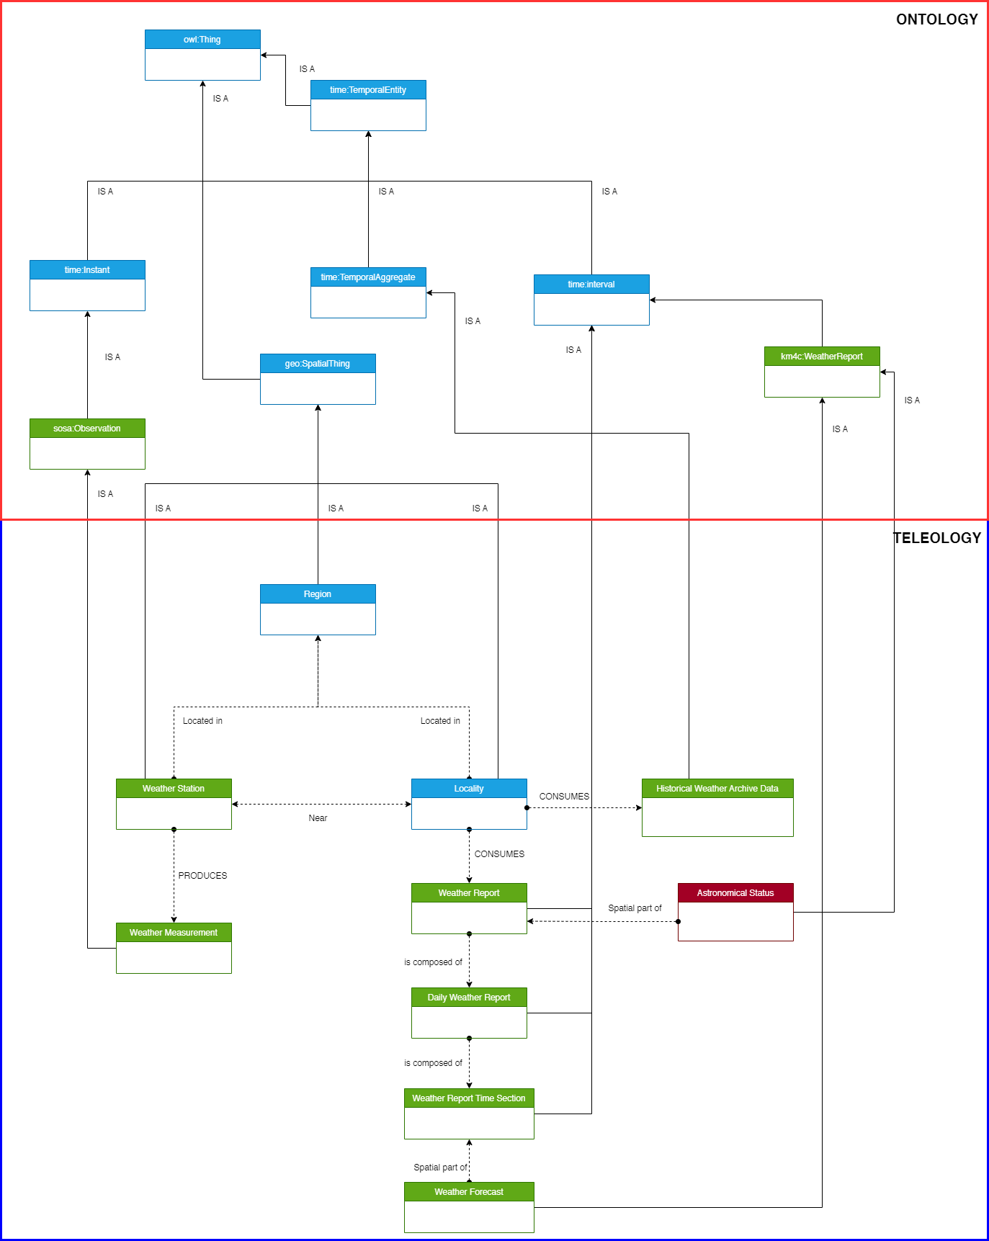
Formal Modeling

Slide 15
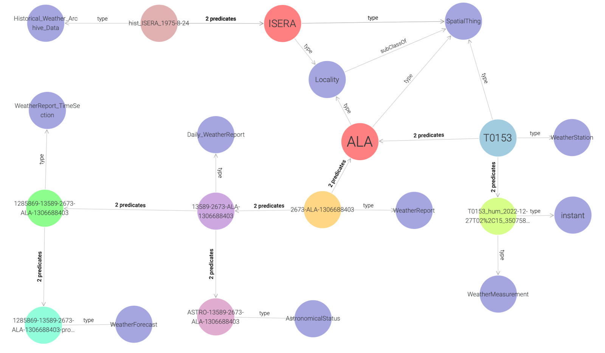
KG

Slide 16
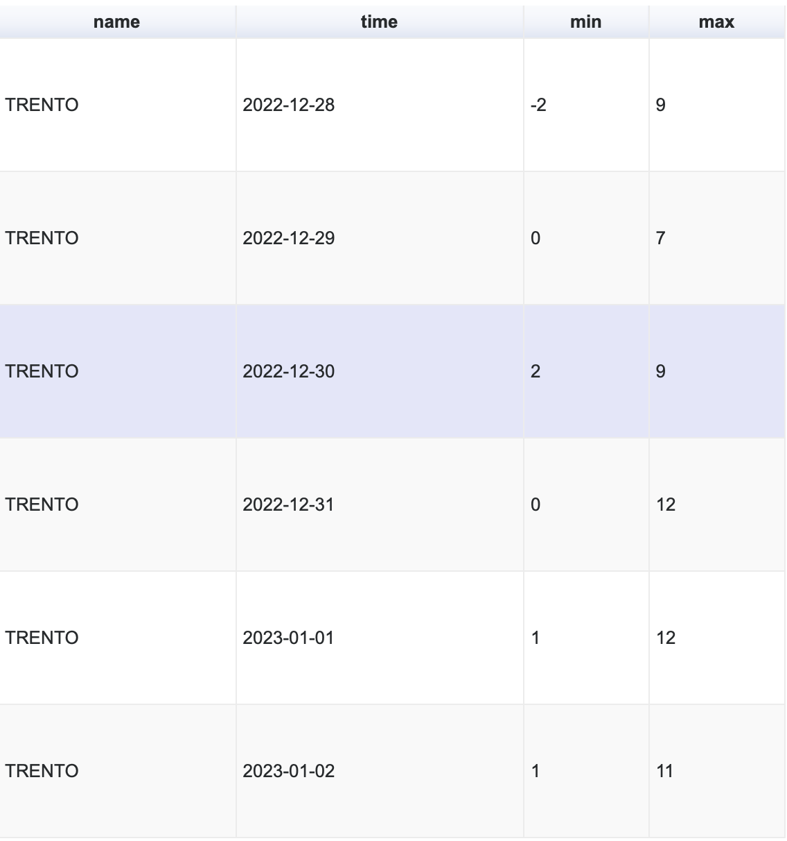
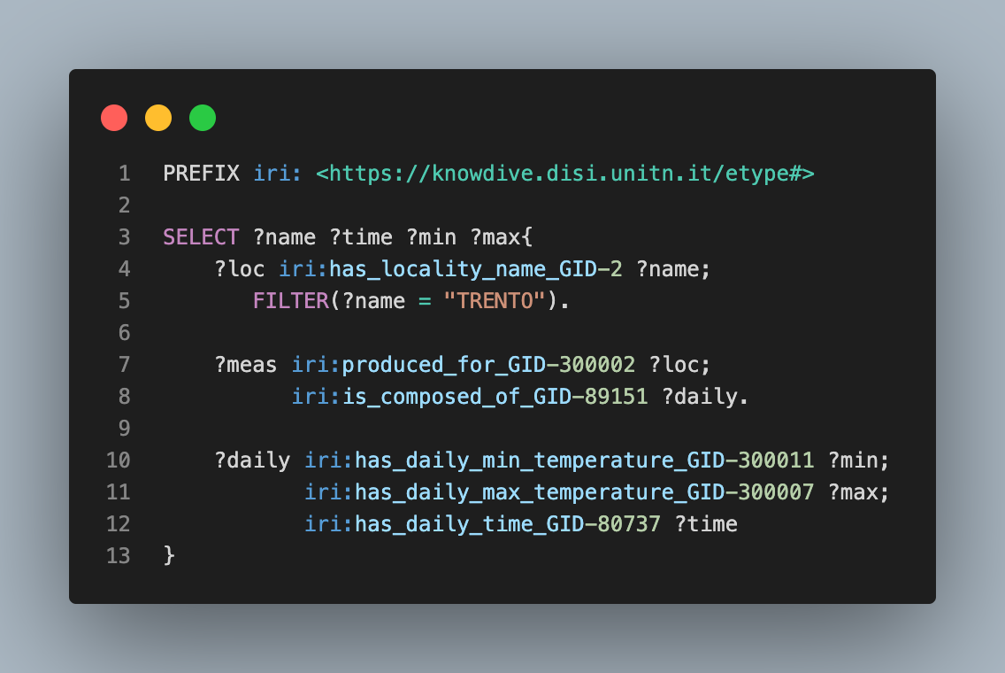
Exploitation

Slide 17
Thanks !

